Slide 1


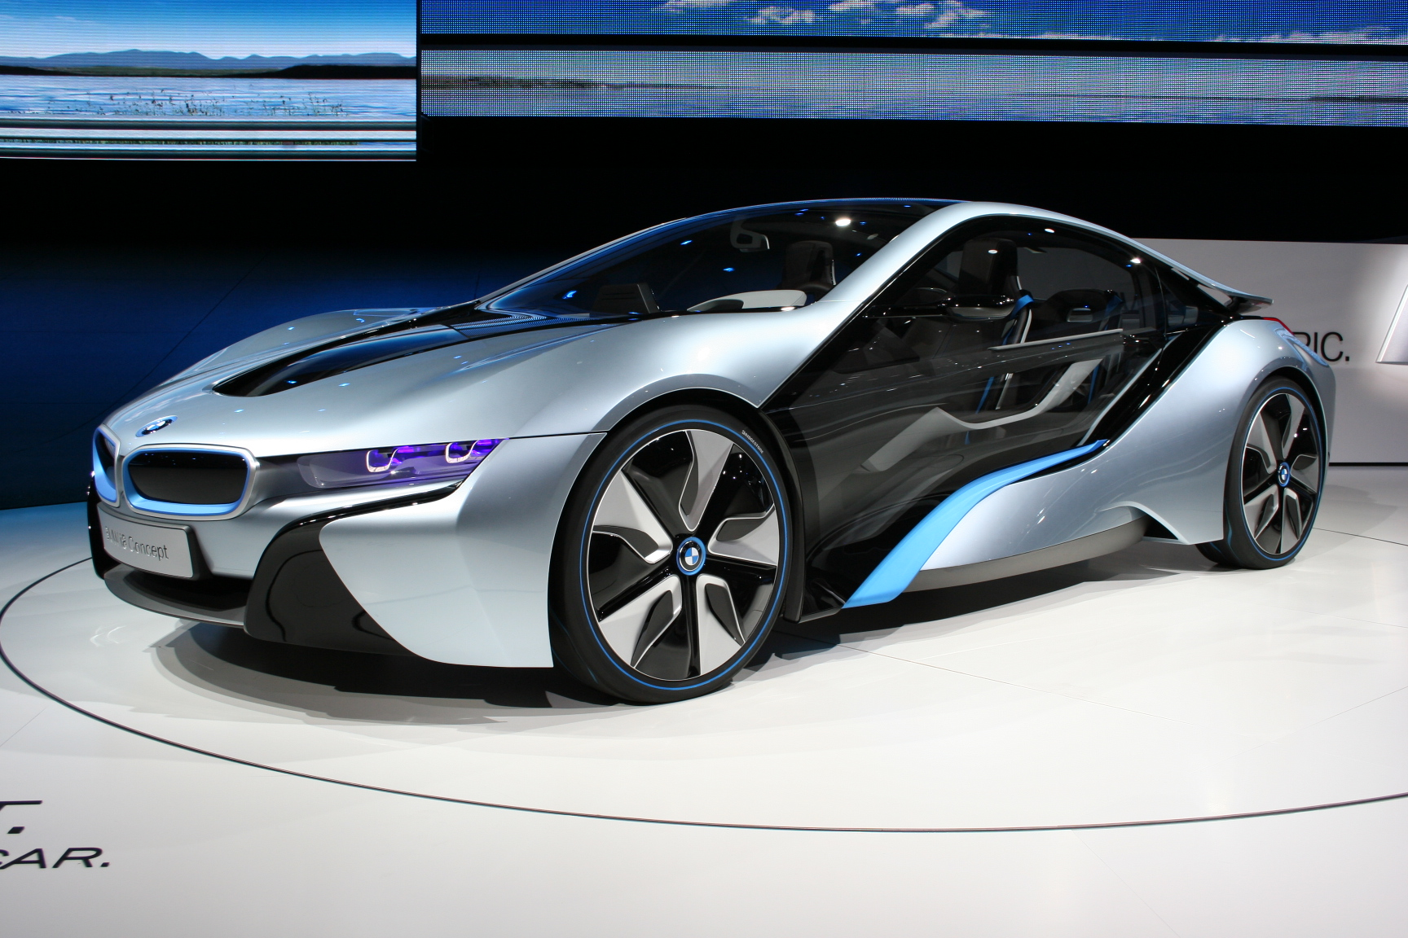

REFACTORY ACADEMY
DATA SCIENCE AND MACHINE LEARNING
PROJECT PRESENTATION
PROJECT TITLE
PREDICTING THE REVENUE OF BMW VEHICLE SALES
ThePhoto by PhotoAuthor is licensed under CCYYSA.

Slide 2
BACKGROUND
Leverage historical BMW sales data (2010–2024) to forecast future revenue and inform strategic decisions. Predictive analytics in automotive retail can identify emerging trends and guide pricing and inventory strategies
Project goals include revenue prediction (classification of sales into high/low revenue categories), pricing optimization, and analysis of customer preferences across markets.
Machine learning provides data-driven insights: by analyzing past sales, we can anticipate demand fluctuations and tailor marketing efforts for maximum revenue.

Slide 3

PROBLEM STATEMENT
BMW vehicle sales revenue due to the complex interplay of vehicle features (such as model type, price, engine size, and region). Without a data-driven approach, pricing decisions, inventory planning, and marketing strategies are often based on assumptions rather than actual customer preferences or market trends.
This leads to overproduction of low demand models ,ineffective marketing etc hence the need to Build a machine learning model to predict the revenue of BMW Vehicle Sales through customer preferences, pricing optimization, and sales forecasting using multi-feature data (2010-2014).

Slide 4



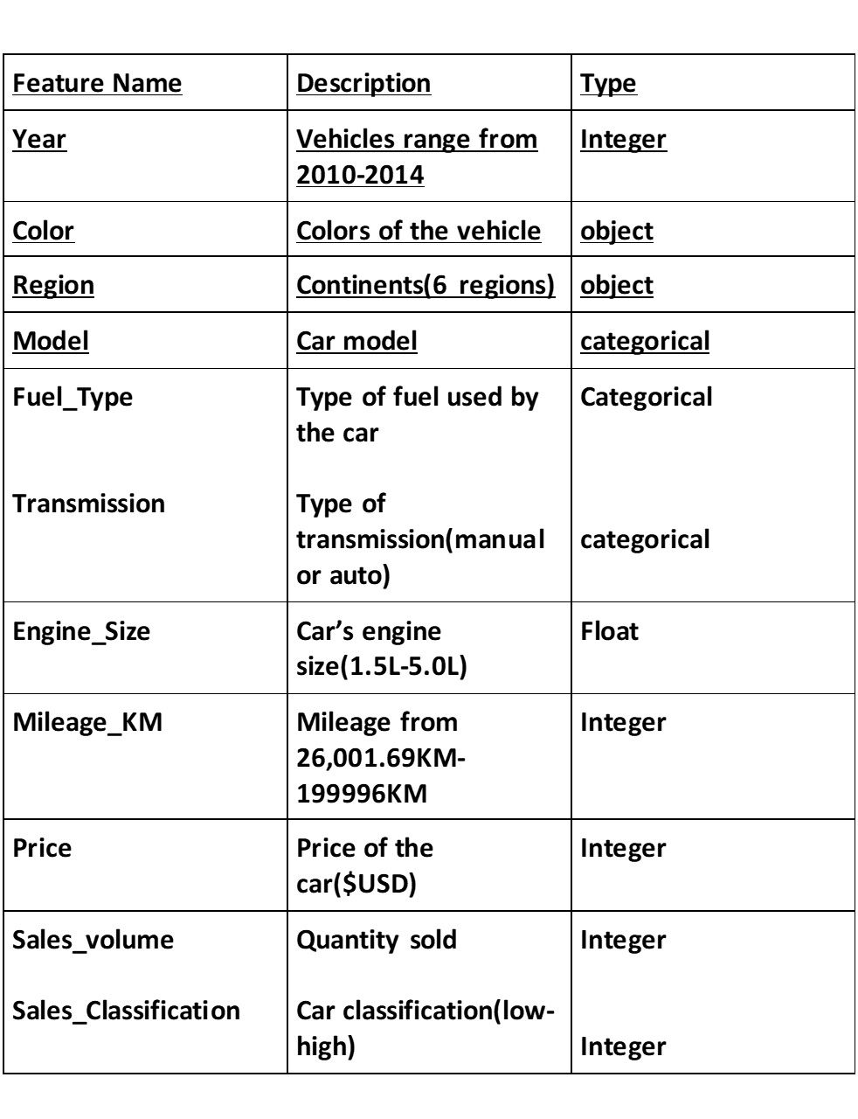
DATA OVERVIEW
Data source; https://www.kaggle.com/datasets/zubairamuti/bmw-car-sales-record-2010-2024
Scope; 30,000 BMW sales records from North America , Africa, Middle East ,and South Africa
TOOLS USED
Pandas
matplotlib
jupyter notebook
GitHub
Seaborn

Slide 5

Data Cleaning
Described the dataset
Checked for missing values and duplicates
Created the revenue column by multiplying the sales volume and the price
Grouped the data by region
We did not have missing values and duplicates.

Slide 6
VISUALIZATIONS
Using matplotlib, we plotted a bar graph to show the relationship between region and revenue. The bar graph shows that Europe has the highest revenue, followed by Asia, North America, Africa, Middle East, and lastly South America.
Performed a multivariate (plotted two types of graphs on the same scale) to understand the relation between region and revenue .
Furthermore, we plotted a side-by-side graph to understand the relationship between revenue and engine size.

Slide 7
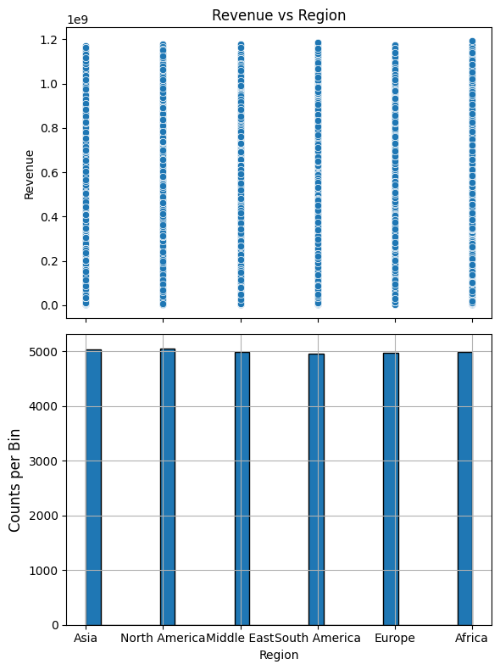
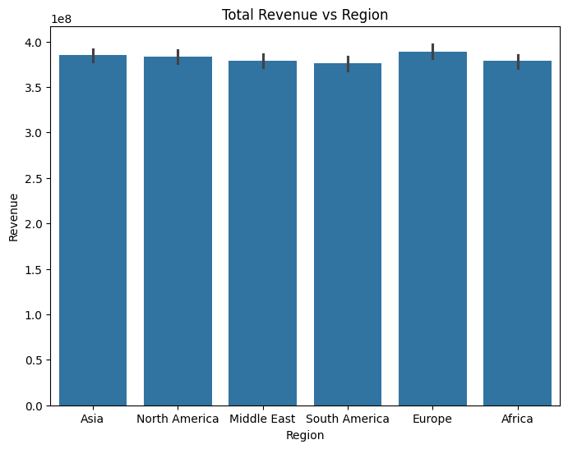
Visualization

Slide 8
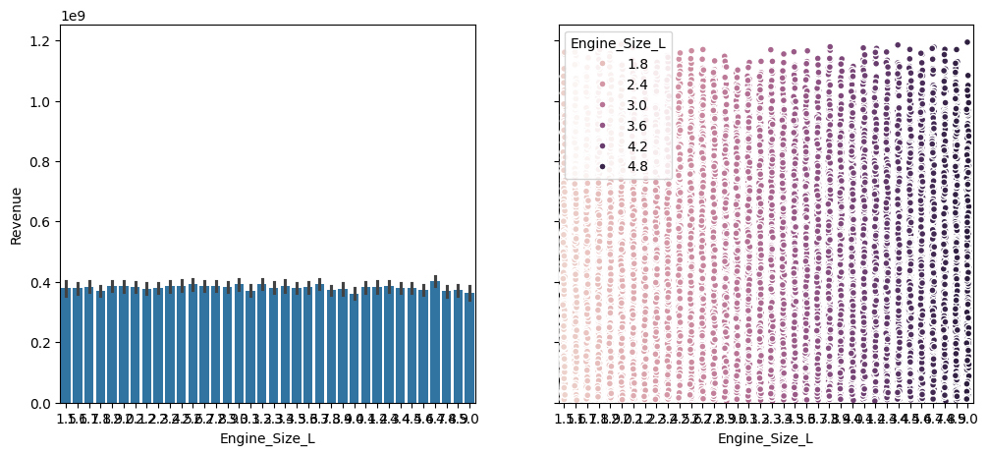
Visualization

Slide 9
FEATURE ENGINEERING ​
One-hot encoded the categorical column which included, fuel type, region, color, transmission and model.
We selected the target column which is the sales volume.
Split the data, training set and test set. Training data was 75% and test data 25%.
LOGISTIC REGRESSION MODEL
Trained and fitted our data into the model
Metrics: Accuracy: Approximately 91%, confusion matrix: 178 false negatives, Mean absolute error = 679, root mean squared error = 857.8, R2 score = 0.91

Slide 10
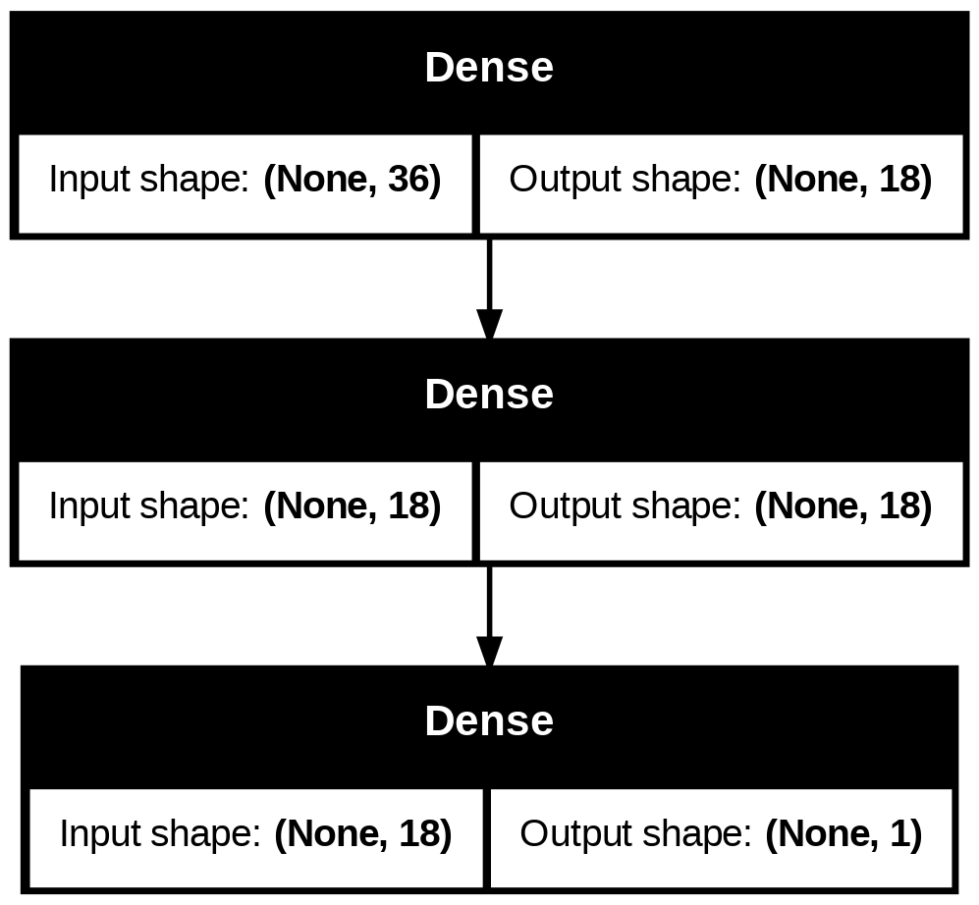


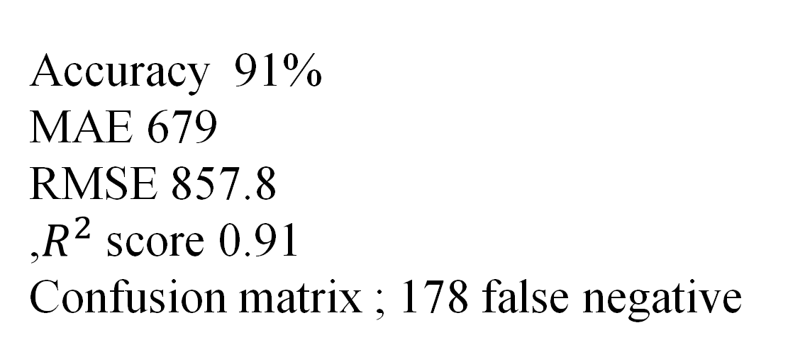
Model Performance
Accuracy 91%
MAE 679
RMSE 857.8
,$R^{2}$ score 0.91
Confusion matrix ; 178 false negative
Interpretation of Results
High accuracy (91%) indicates strong predictive power.
Data points form a near-diagonal line in prediction plot → strong positive correlation.
R² = 0.91 means 91% of revenue variation is explained by the model.

Slide 11
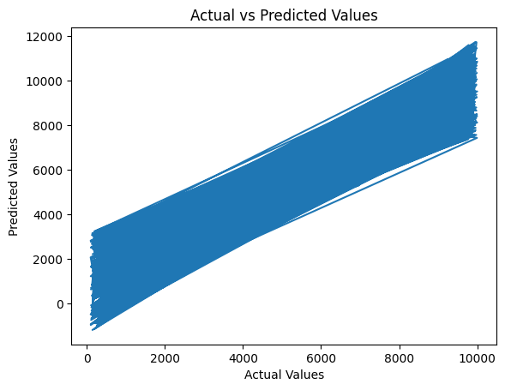

Conclusions

Slide 12

Thank You

